Slide 1


28/7/2026
AAROGYA CENTER
Campus Health &
Medical Committee (CHMC)
00 / 04 / 2022
1
Services of Aarogya
Aarogya Centre provides primary medical care to the faculty, staff students, on campus residents & outsource staff etc.
We have daily doctors visiting to campus on hourly based and 24/7 nurse service from Care Hospitals (MoU)
The medical services that we provided include – Outpatient care, In- patient care, Emergency care services (ER), Laboratory services at Care Hospitals (MoU)
We have visiting consultants for Gynaecology, Paediatrics, Dentistry and who come on a monthly basis.
We also provide telephonic video consultation, lab services for patients who are unable to come to the aarogya centre.
2

Slide 2
28/7/2026
CHMC members
Dr. Anil Kumar Vuppala, Chair
Prof. Shatrunjay Rawat, (Chair QRA)
Ms. Pranjali Kanade, Chief warden (Member)
Asst. Prof. Bhaktee Dongaonkar, Coordinator, Mental Health (Member)
Mr. Manas Ranjan Mohanta (Secretary)
Mr. (Nominee), Hostel Incharge (Admin Support for Mental Health)
Counsellors & Medical Doctors, (Invitees)
https://well-being.iiit.ac.in/about/
3
Services & Facilities
Daily visiting doctors
General physician from care hospital (1 Day+1 Evening)
Ayurvedic : 01
Homeopathy: 01
24/7 nurse service
Aarogya contact: 040-6653 1656
24/7 Ambulance service: Contact 99891 38983
Psychological counselling service
Psychiatrist (1)
Counselling Psychologist (1)
RCI Rehabilitation Psychologist & Psychotherapist (1)
General medicines
Nebulisation
Oxygen concentrators
4

Slide 3

28/7/2026
MOU with Hospitals (near by)
Care Hospitals (IP and OP)
Old Mumbai Hwy, near Cyberabad Police Commissionerate Jayabheri Pine Valley, HITEC City, Hyderabad, Telangana 500032
Rainbow Children’s Medicare Limited (OP)
Survey No 74, Rainbow Children's Hospital & Birthright,
Financial District, Nanakramguda, Hyderabad, Telangana 500008
AIG (A Unit Of Asian Institute Of Gastroenterolgy)-MoU in progress
1-66/AIG/2 to 5, Mindspace Road, Gachibowli Hyderabad, Telangana 500032
*Good offices with Himagiri Hospitals and Continental Hospitals
5
Medical team & their timings
General physicians visiting hours from Care Hospitals as per MoU
Other medical team
Morning: 10.00 am to 12.00 pm
Evening: 04.00 pm to 06.00 pm
Saturday off
Sunday 10.00am to 12.00 noon
*24/7 nurse service (365 days)
Counsellors:
Dr. Vinaya Ballakur, Ayurvedic Physician Working days: Monday & Wednesday Timings: 10:00 am to 12.00 pm
Dr. Subhashini Reddy, Homeopathy Physician Working day: Thursday
Timings: 11.00am to 01.00 pm
Dr. Chyaithanya Deepak, Psychiatrist (Asha Hospitals) Visiting days: Tuesday and Thursday
Visiting hours: 10.00am to 12.00 pm
Ms. B. Kiranmaiyee, PhD psychology, Counselling Psychologist Visiting days: Monday & Friday
Visiting hours: 02.00 pm to 04.00 pm
Ms., Tanusree Mustafi, RCI Certificate, Rehabilition Psychologist and Psychotherapist Visiting days: Wednesday & Saturday
Visiting hours: 02.00 pm to 04.00 pm
6

Slide 4
28/7/2026
Benefits from Care MoU
Sl No | Particulars | Discount Structure
1 | Out Patient Consultation Discount | 20%
2 | Out Patient Diagnostic Discount | 20%
3 | Health Check Packages | 20%
4 | In Patient Discount (Applicable to Cash Payment only). Not Applicable for Insurance Patients | 5% Excluding MRP items such as, but not limited to, Pharmacy Items, Consumables, Stents, Implants etc.)
5 | Free One Step room up-gradation at the time of IP admission. (If available)
7
Benefits from Rainbow Hospitals
Sl No | Particulars | Discount on the existing cash tariff
1 | OPD consultation (Specialist/Super specialist) | 10%
2 | Lab investigations (excluding outsourced tests) | 20%
3 | Radiology (X-day, CT, USG) | 10%
4 | Any other OPD procedures | 10%
5 | IPD for cash paying patient (excluding packages, consumables, implants and pharmacy) | 10%
6 | Pharmacy, Dental procedures and on emergency care | NIL
8

Slide 5
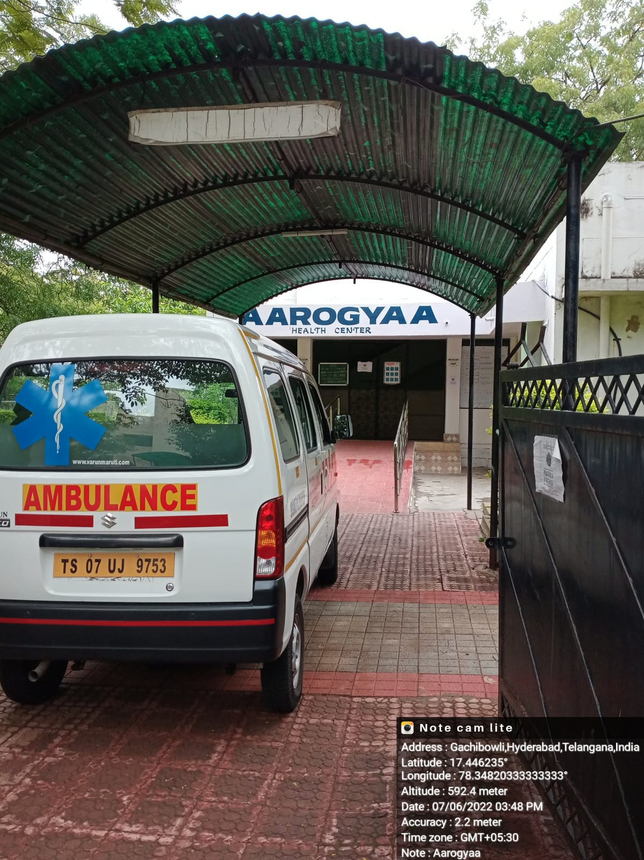
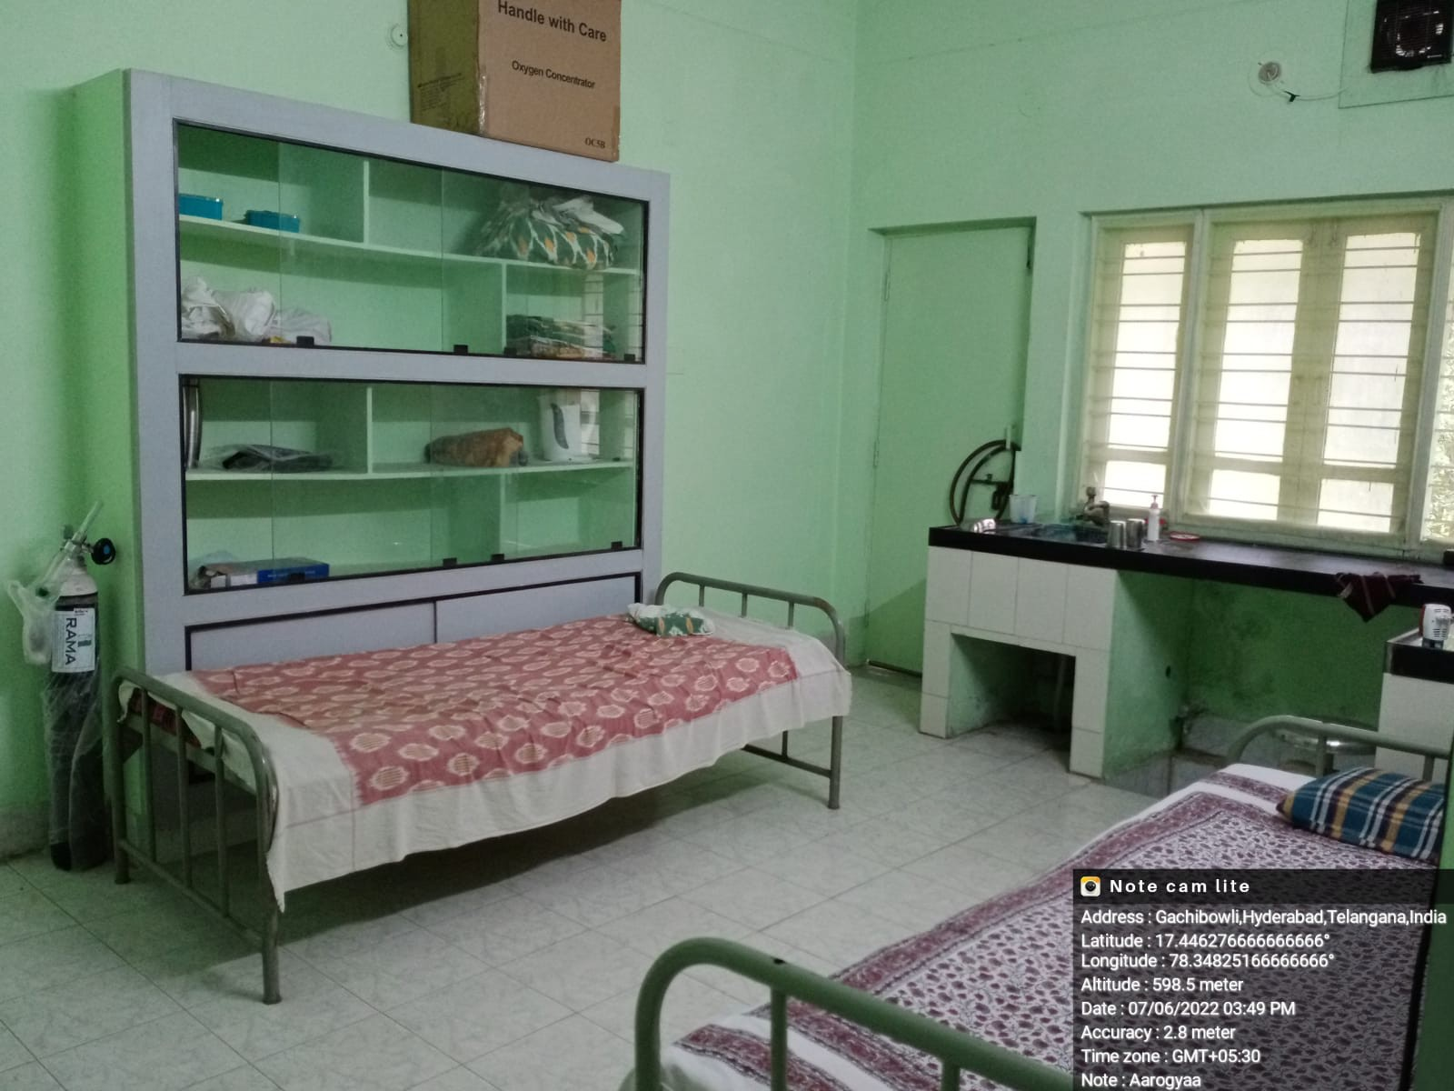
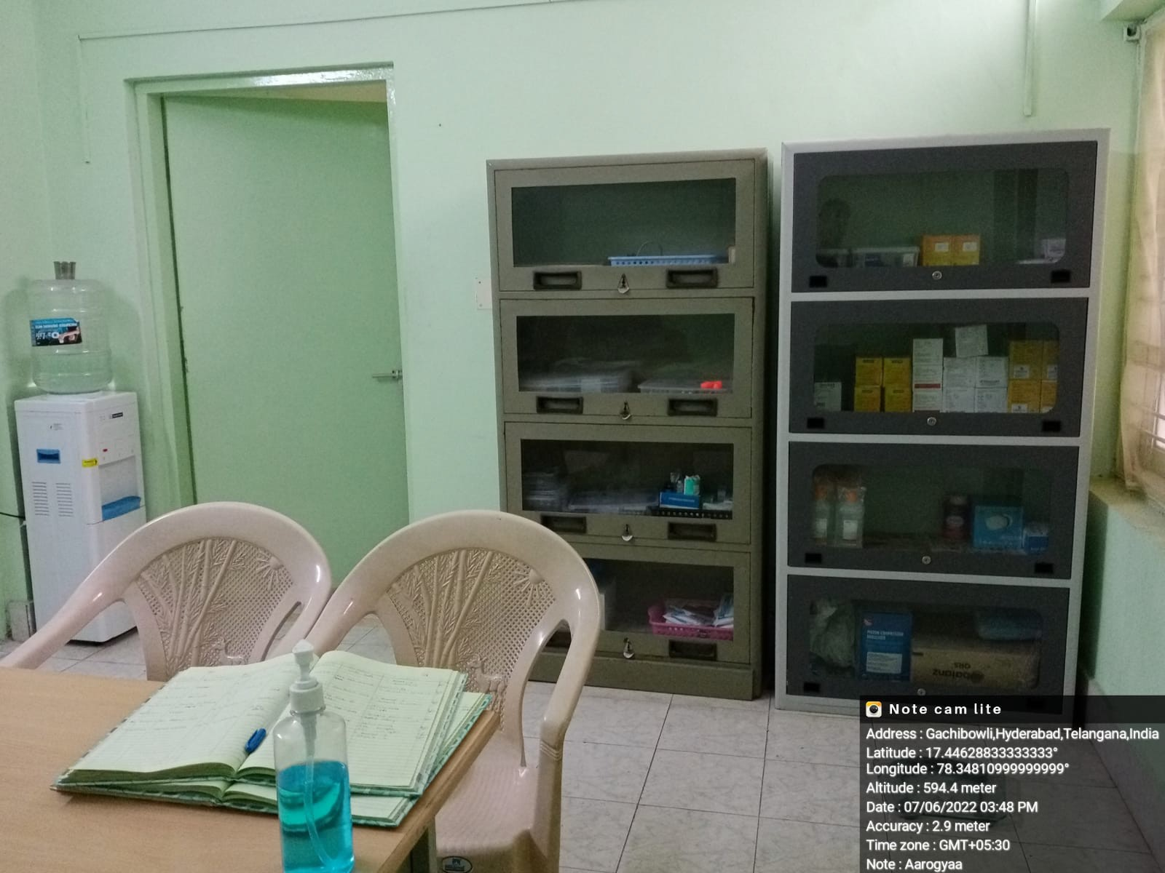
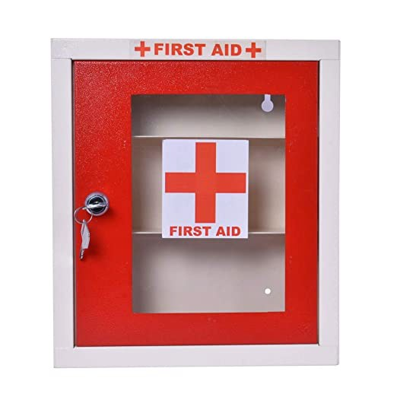

28/7/2026
9
10

